Slide 1
Chapter 23 – Industrialization of the West – 1760-1914
The Age of revolution:
Population revolution: Huge growth in population in western Europe beginning about 1730
Protoindustrialization: Preliminary shift away from an agricultural economy; workers became full or part-time producers who worked at home in a capitalist system in which materials, work orders and sales depended on urban merchants; prelude to the Industrial Revolution.

Slide 2
American Revolution: Rebellion of the British American Atlantic seaboard colonies; ended with the formation of the United States of America
French Revolution: overthrow of the Bourbon monarchy through a revolution beginning in 1789; created a republic and eventually ended with Napoleon's French empire; the source of many liberal movements and constitutions in Europe. Ended with King Louis XVI being beheaded!
Declaration of the Rights of Man and the Citizen: adopted during the French Revolution; proclaimed the equality of French citizens; became a source document for later liberal movements.

Slide 3
Guillotine: Introduced as a method of “humane” execution; used during the French revolution against thousands of individuals, especially during the “Reign of Terror.”
Napoleon Bonaparte: Army officer who rose in rank during the wars of the French Revolution; ended the democratic phase of the revolution; became emperor; overthrown and exiled in 1815.
Congress of Vienna: Met in 1815 after the defeat of France to restore the European balance of power.

Slide 4
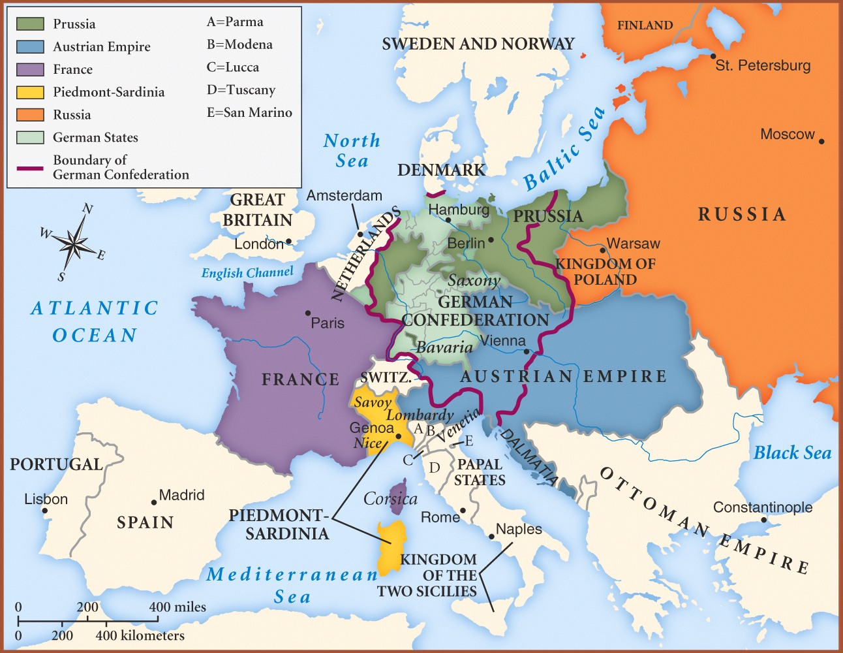
Europe AFTER the Congress of Vienna - 1815

Slide 5
Liberalism: political ideology that flourished in 19th century western Europe; stressed limited state interference in private life, representation of the people in government; urged importance of constitutional rule and parliaments.
Liberals sought to gain political power with the economic power of the middle classes; they wanted limited constitutional government.
Socialism: political ideology in 19th century Europe; attacked private property in the name of equality; wanted state control of the means of production and an end to the capitalistic exploitation of the working man

Slide 6
Nationalism: European 19th century viewpoint; urged the importance of national unity; valued a collective identity based on ethnic origins.
Radicals: Followers of a 19th century Western European political emphasis; advocated broader voting rights than liberals did; urged reforms favoring the lower classes.
Greek Revolution: 1820’s; series of revolts; first step in dismantling the Ottoman Empire
Reform Bill of 1832: gave parliamentary vote to most middle-class men in Britain.

Slide 7
The Industrial Revolution
Factors leading to British Industrial Revolution:
Favorable natural resources
Population pressure forced innovations at all levels of society
Increasing world trade
Growth of manufacturing sector of the economy
Governments committing policies of economic growth

Slide 8
The Industrial Revolution
James Watt: devised a steam engine in 1770’s
Improvements in agriculture
Population boom
Example: Manchester, England; small village, then boomed to several hundred thousands of people
Environmental effects:
Less need for forests, but smoke pollution in air increased; also, factory wastes and population boom affected water quality in some areas

Slide 9
Effects of Industrialization in Cities
Migrations
Mostly young adults
Poor health conditions
Packed housing
Inadequate sanitation (see “environmental effects” from previous slide)
Crowded cities
Population boom & movement

Slide 10
Effects of Industrialization on Social/Family Life
Women and children still “sheltered” from the industrialized work world
Women mainly took care of children at home
Moral status improved
Middle-class was improving (and growing)
Education was more important for children than work/apprenticeship
Social structure relied less on privilege & birth and more on money

Slide 11
Revolutions of 1848-1849
Paris, France
French monarchy overthrown…again!
This time for good
Democratic-Republic temporarily set up
Wanted social reforms:
Women’s rights & voting rights
Jobs for the unemployed (socialism)
(More demands than the original French Revolution of 1789)

Slide 12
Revolutions of 1848-1849
Revolution spread to other areas of Europe: Germany, Austria, & Hungary
Revolutions died down by the later-1800’s
Failure in some revolutions taught liberals that it was too risky → should use more gradual methods

Slide 13
1850-1914 ish
1880-1920→improved children’s health
Child death rates now less than 10% (dying by age 10)
Labor strike among industrial workers in 1890’s
Many in USA and Germany
Italy unified → most by 1870’s
Reduces power of the Pope & Catholic Church
Germany unified in 1871 after war w/ France
Many Western governments began using civil service exams (like the Chinese thousands of years before!)

Slide 14
1850-1914 ish
Education became common. Most schooling done up to age 12; governments believed education provided basic work skills
Literacy rates improved: by 1900, 90-95% of all adults in western Europe & USA could read

Slide 15
Socialism
All about the working class
Depended on the grievances of/against the working class
Karl Marx (Marxism)
According to Marx: “History was shaped by the available means of production and who controlled those means”
The middle class had won the battle because they owned land; they had a strong hold on the lands available to people, therefore they controlled the means of production.
The “enemy” then, was the property-less proletariat (lower class)
Marx told the working class that their wages were exploitive and unfair.
Urged the need for violent action

Slide 16
Socialism - continued
The rise of socialism scared people of “Western” society
Germany (led by Otto von Bismark) became largest single political force by 1900
Major industrial strikes and the forming of unions rose quickly
Socialist parties would ally themselves with other moderate groups to strengthen themselves
In the end, Marx’s vision was incorrect; success could be achieved by peaceful democratic means and NOT only by violent revolts

Slide 17
Feminist Movement - 1900
Sought various legal and economic gains for women
Equal access to higher education
Right to vote
USA, Britain, and Germany all granted women the right to vote after 1918
Big boost from middle-class women

Slide 18
Beginnings of World War I
Triple Alliance:
Germany
Italy
Austria-Hungary
Triple Entente:
France
Britain
Russia

